Slide 1

E-Commerce Website
Prepared by:
Gracy patel 19012021052 IT
Hirva khunt 19012011019 CE

Slide 2
Contents
Why E-commerce website?
Website features
Website system development and life-cycle.
Technologies to be used

Slide 3
Why E-commerce website?
Reasons why people shop online today.
Price – Products prices are mostly low in online shops compared to traditional shops.
Convenience – E-commerce websites are much more convenient.
Variety – Numerous varieties of products are available.
Timid to buy from a store in the presence of people

Slide 4
Why E-commerce website?
Furthermore, the spread of the Covid-19 pandemic has caused a lot of changes in our lifestyle, people fearing to get outside their homes, transportation almost shut down and social distancing becoming all the more important. Big to small scale business that relied on the traditional incur a lot of consequence due to the lockdown issues. Some tend to more towards using social media platforms like Facebook to sell their product. However, the social media platforms have been beneficial for marketing purposes alone but leaves the whole task of customer and massive order management via direct messaging (DM), which takes a lot of time to respond to all customers.
In addition, everyone tends to use social media, posing a great challenge to differentiate between scammers (fraudsters) and legit sellers.

Slide 5
Website features
Display products, Purchase methods
Shipping
Admin panel
Specific Categories

Slide 6
Proposed project would cover:
Customer Side
Customer can view/search products without login.
Customer can also add/remove product to cart without login (if customer try to add same product in cart. It will add only one)
When customer try to purchase product, then he/she must login to system.
After creating account and login to system, he/she can place order.
Customer can check their ordered details by clicking on orders button.
Customer can see the order status (Pending, Confirmed, Delivered) for each order

Slide 7
Proposed project would cover:
Administrator Side
Admin can provide username, email, password and your admin account will be created.
After login, there is a dashboard where admin can see how many customers is registered, how many products are there for sale, how many orders placed.
Admin can add/delete/view/edit the products.
Admin can view/edit/delete customer details.
Admin can view/delete orders.
Admin can change status of order (order is pending, confirmed, out for delivery, delivered)

Slide 8
Website system development and life-cycle.
System analysis/planning – Gathering information
System design – UI of the website
System building - Implementation of UI
Testing – Testing of the website
Implementation of service

Slide 9
Technologies to be used
Back-end:
Python Django Framework - Django is a high-level Python web framework that encourages rapid development and clean, pragmatic design.
Front-end: HTML , CSS , Bootstrap

Slide 10
System Modules
Admin | Seller | Customer
Login | Login/Sign Up | Login/Sign Up
Add seller or customer | - | -
remove seller or customer | - | -
Restrict seller or customer | - | -
- | Add products | -
Delete products | - | -
View products | View products | View products
- | - | Purchase product
- | - | Bill payment
Sign Out | Sign out | Sign out

Slide 11
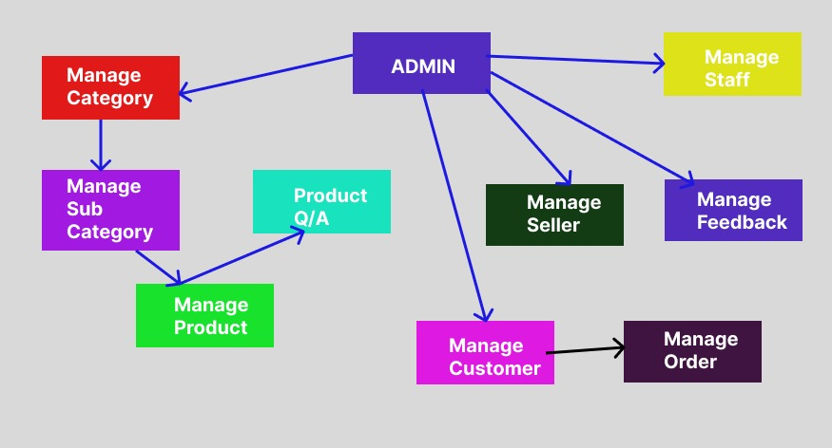
Admin Module

Slide 12
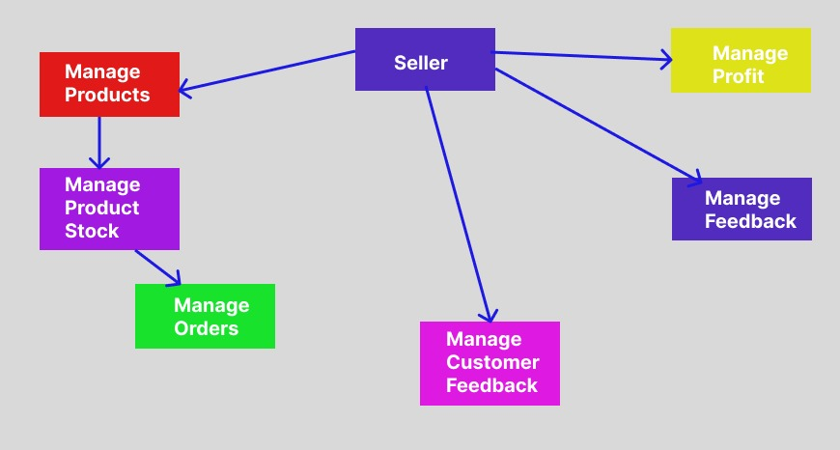
Seller Module

Slide 13
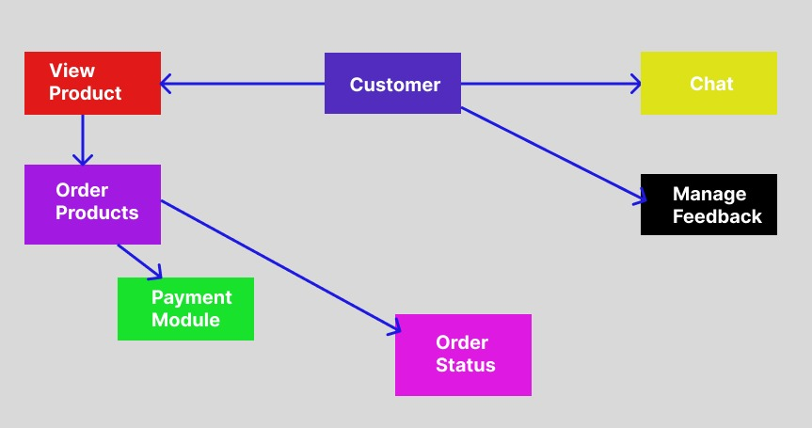
Customer Module

Slide 14
Thank you

